Slide 1

MACHINE LEARNING PROJECT SURVEY
Vision-UI
Desktop GUI grounding for evidence-first user activity narration
Grounding • desktop data • narrative fidelity
Project 2 • Topic & Dataset Survey

Slide 2

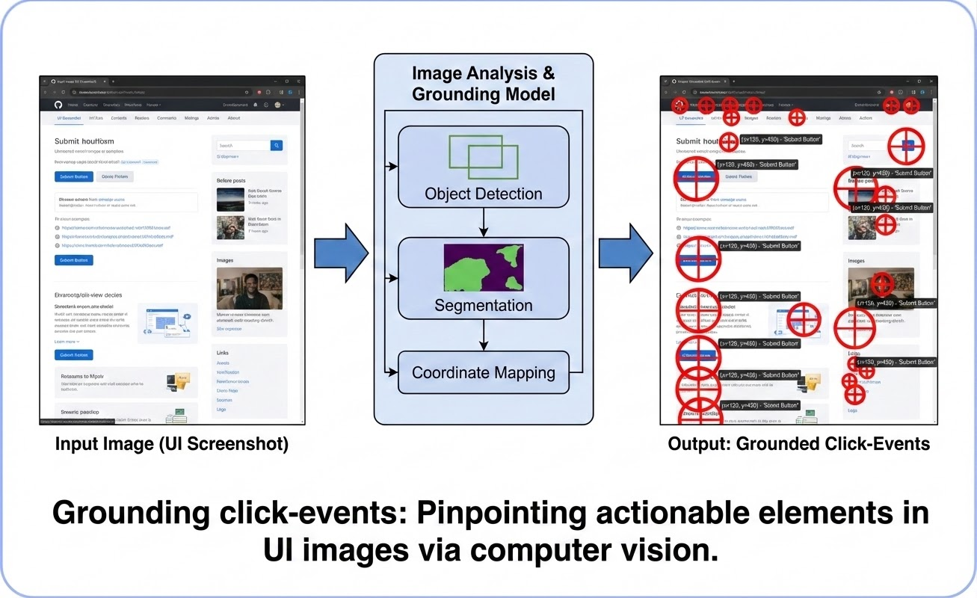
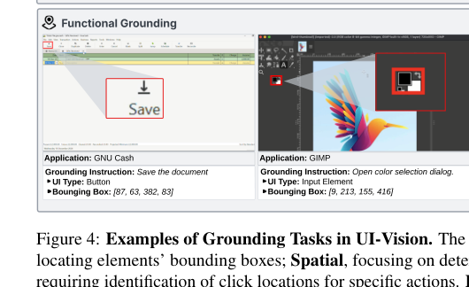
PROBLEM FRAMING
The Problem Is Not Capture — It Is Interpretation
Logs and screenshots exist already; the missing layer is explaining what the user actually targeted and saw on screen.
Traditional logs
Useful for processes and timestamps, but weak at explaining visible intent.
Screenshot archives
Preserve the screen faithfully, but leave ambiguity about which element mattered.
Missing layer
A usable activity log needs grounded GUI evidence: which control was clicked and what semantic role it played.
A click event becomes useful only after the system maps it to the correct UI element.
Vision-UI produces structured JSON evidence plus a readable session narrative.
screenshot + OS context
→
grounded element
→
JSON evidence
→
narrative log
Without grounding, the log may say a click happened but not whether the user hit “Save.”
02

Slide 3
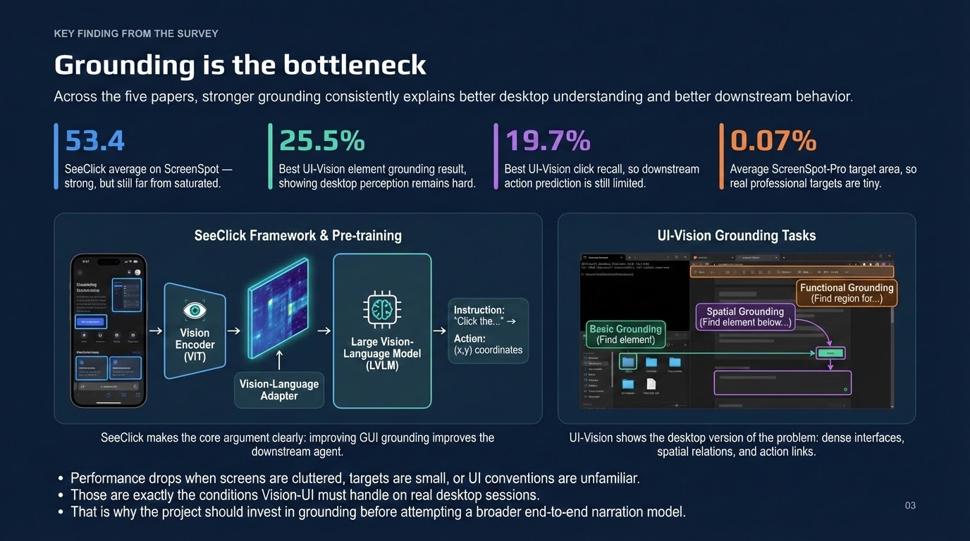

Slide 4
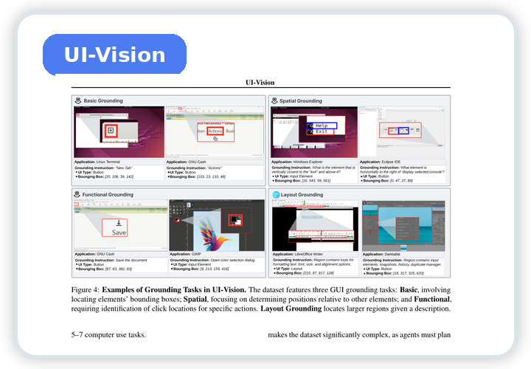
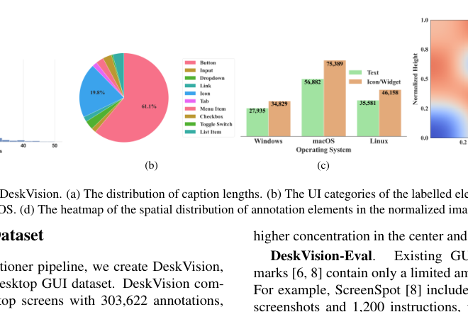
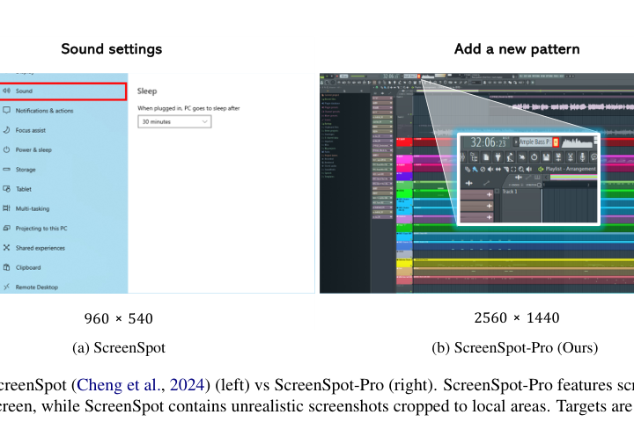
DATASET DESCRIPTION
A Layered Dataset Strategy Fits Vision-UI
No single public dataset matches the full system, so training, priors, external evaluation, and local adaptation each come from a different source.
UI-Vision
DeskVision
Auxiliary visual priors
54k screens, 303k annotations
Windows, macOS, and Linux
Weak supervision at scale
Primary supervised source
83 apps, 450 demos, 8,227 pairs
Dense boxes & action trajectories
Best matches click-aware grounding
ScreenSpot-Pro
Local Adaptation
External robustness
1,581 instructions, 23 apps
0.07% average target area
Full-screen professional difficulty
Real session calibration
~240 proprietary examples
590 screenshots, 22 sessions
Captures pipeline failure modes
{
"click_xy": [x,y],
"bbox": [x1,y1,x2,y2],
"role": "semantic"
}
Train (UI-Vision) → Augment (DeskVision) → Evaluate (ScreenSpot) → Calibrate (Local)
04

Slide 5
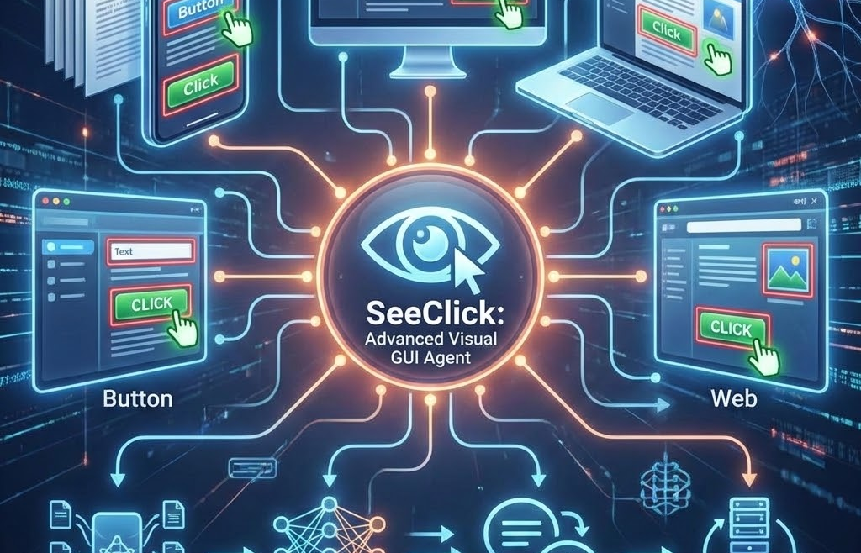
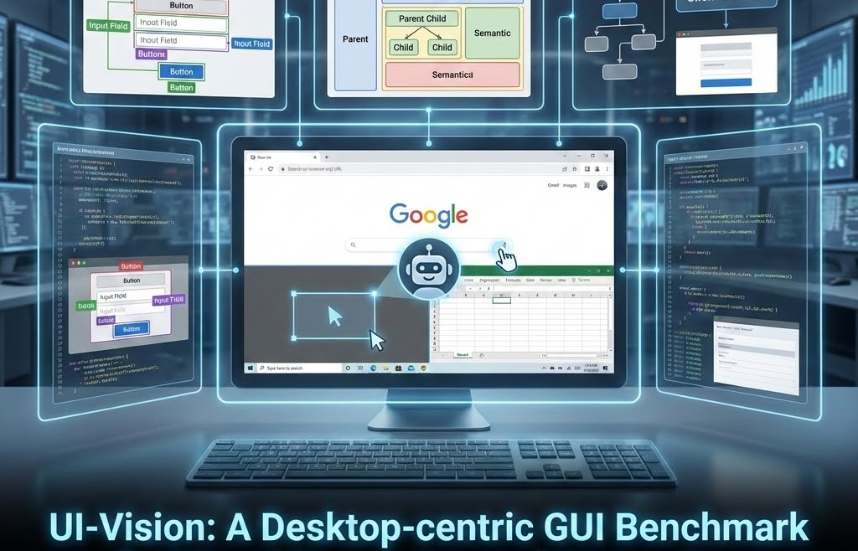
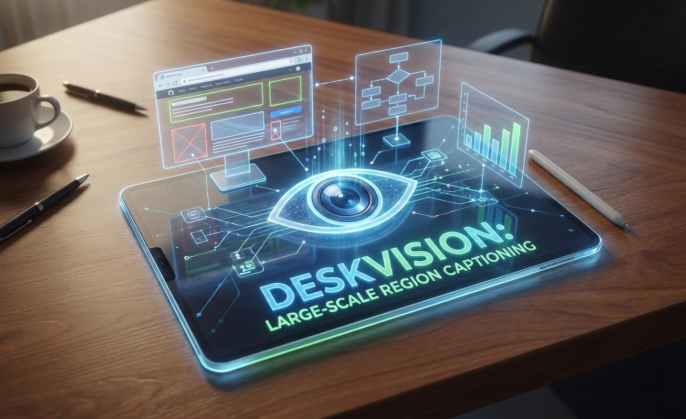
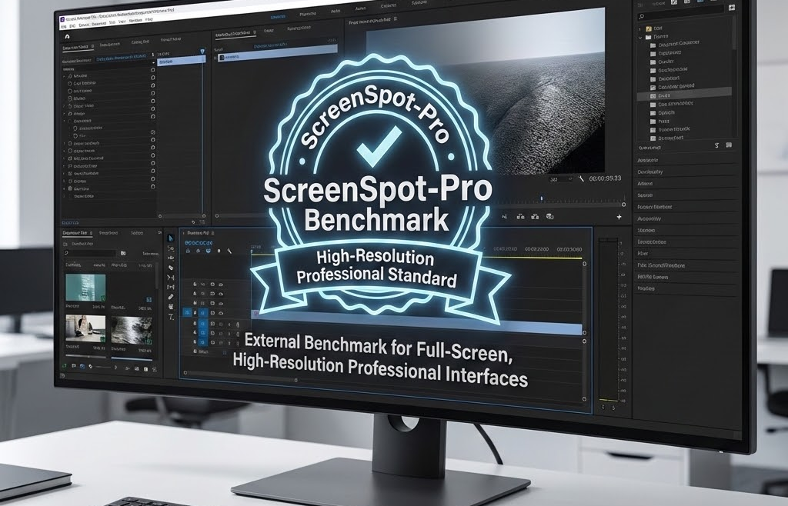
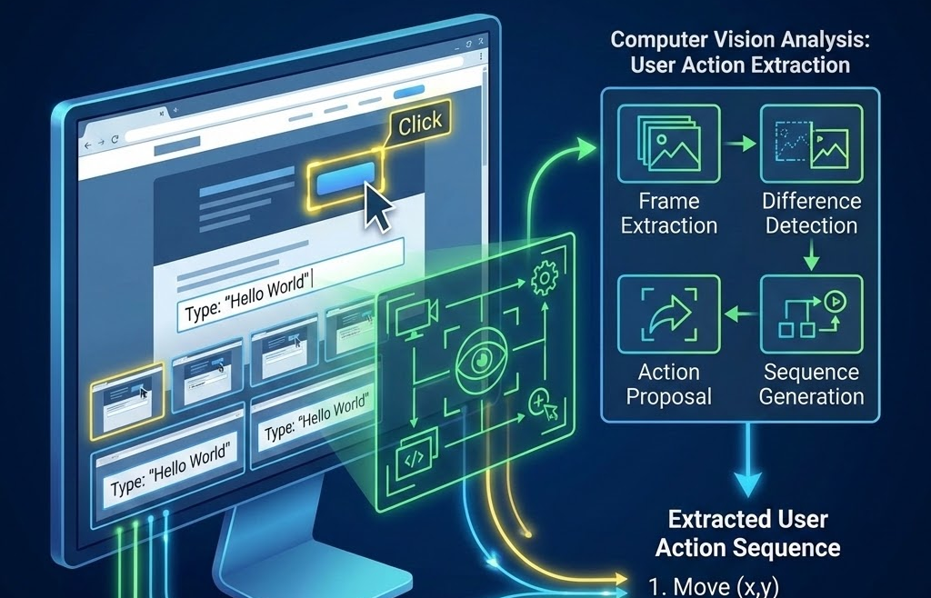
RELATED WORK
The Five Papers Form One Coherent Story
Each paper contributes a different piece of the final argument, and together they point to a narrow, defensible ML target.
SeeClick
UI-Vision
DeskVision
ScreenSpot-Pro
Sharingan
Why grounding is the core bottleneck for screenshot-only GUI understanding.
Best human-annotated desktop benchmark for dense grounding and action-aware supervision.
Large-scale desktop captions and cross-platform visual priors for better coverage.
Hard external benchmark for full-screen, high-resolution professional interfaces.
Why stronger frame understanding should improve downstream action extraction.
Research flow
bottleneck → supervision → scale → stress test → downstream impact
Together these papers argue for a compact desktop grounding module inside an evidence-first pipeline — not a broad end-to-end agent replacement.
05

Slide 6
COMPARATIVE ANALYSIS
Historical Research & Where Vision-UI Fits
The strongest papers answer pieces of the problem, but none combine desktop grounding, OS context, deterministic narration, and local fallback in one system.
SeeClick
Evidence:
Grounding pre-training improves GUI behavior; 53.4% on ScreenSpot.
Missing:
Not desktop-specific or local-first.
UI-Vision
Evidence:
83 apps, 450 demos; best element grounding is 25.5%.
Missing:
Benchmark only; not a deployable system.
DeskVision
Evidence:
54k screens add real desktop scale and priors.
Missing:
Captions are weaker/noisier than action traces.
ScreenSpot-Pro
Evidence:
ScreenSeekeR lifts resolution targets from 18.9% to 48.1%.
Missing:
An evaluation benchmark, not a full design.
Sharingan
Evidence:
GPT-4o reaches 0.83 recall on ACTONE operations.
Missing:
Focuses on video, not grounded JSON evidence.
Vision-UI Gap
Desktop-first grounding
OS context + screenshot evidence
deterministic narration + fallback
public + local evaluation
Together these papers argue for a compact desktop grounding module inside an evidence-first pipeline.
06

Slide 7
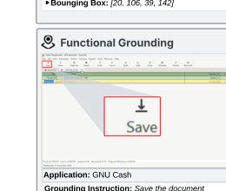
PROPOSED IDEA
Proposed Idea: A Hybrid Local-First Grounding Layer
Keep the deterministic pipeline intact; strengthen only the stage that decides which on-screen element a user event actually targets.
Capture
screenshots
+ OS events
Proposals
candidate regions from OCR, contours, and heuristics
Classifier
MobileNetV3-Small predicts one of five role families
Mapping
deterministic rules convert generic roles into app-specific semantics
Output
additive JSON evidence feeds the existing narrator
Portable role families
The learned model predicts portable GUI semantics, and deterministic logic keeps the project-specific truth-preserving stage.
• input
• button
• list item
• document content
• other
Why this fits Vision-UI
• local-first and on-device friendly
• additive schema with no breaking changes
• graceful fallback when confidence is low
Explicit non-goals
• no end-to-end agent replacement
• no screenshot-to-app classifier
• no server dependency
Example crop
classified as “button”
07

Slide 8
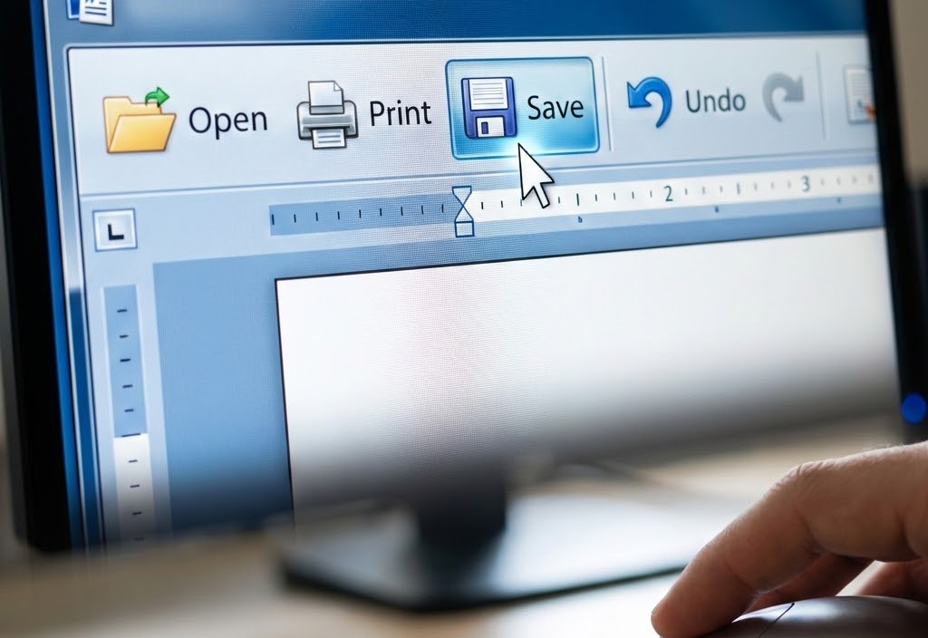
EVALUATION
Evaluation: Success Must Show Up In Narration
A better model matters only if the final evidence and session story become more faithful and less misleading.
Clicked-target top-1
Tests whether the correct GUI element was selected for a click or focus event (IoU ≥ 0.5).
Target:
Absolute improvement in clicked-target grounding accuracy
Macro F1 Roles
Measures whether the model learns portable GUI semantics instead of brittle app labels.
Target:
Improved macro F1 on role-family classification
JSON Accuracy
Checks trusted fields: element_role, target_kind, and surface_type.
Target:
0 regressions when ML disabled
Qualitative Review
Uses sessions to verify the log becomes less vague and less wrong.
Qualitative win:
Fewer wrong targets and cleaner narratives.
Illustrative before / after
Baseline log
“Clicked document surface.”
The goal is not just better IoU. It is fewer misleading explanations in the final user-visible narrative.
Hybrid log
“Clicked Save button.”
08

Slide 9
EXPECTED CONTRIBUTION
Expected Contribution by the End of the Project
A practical, academically defensible repo extension that improves evidence quality without sacrificing interpretability.
What will be new
• A compact on-device grounding layer, not another end-to-end computer-use agent.
• A role-family classifier that sits inside the existing evidence-first JSON pipeline.
• A project-specific benchmark built from current Vision-UI runs and real failure modes.
• A clearer narrative layer for troubleshooting, incident review, and security context.
Next few weeks
01 Curate the local split
Create the project-specific adaptation set from current runs and audit labels.
02 Train the 5-class model
Use UI-Vision as the primary source and DeskVision as auxiliary supervision.
03 Integrate with fallback
Add optional learned fields while preserving deterministic behavior.
04 Benchmark and analyze
Evaluate on local and external desktop sets, then prepare before/after cases.
Why it counts as ML work
• Every design choice is anchored in recent desktop GUI literature and the dataset survey.
• The learned component has a narrow measurable objective: better grounding and role assignment.
• The final output remains interpretable because deterministic narration still controls the last stage.
09

Slide 10

TAKEAWAYS
Vision-UI Takeaways
Desktop GUI grounding for evidence-first user activity narration
The Critical Target
Grounding is the right ML target because it is the main bottleneck across the surveyed papers.
Data Challenge
Desktop-specific data now exists at meaningful scale, but professional interfaces remain difficult.
Our Contribution
Vision-UI contributes a trustworthy interpretation layer between capture and narration.
Mission Complete
The final objective is to support a clearer sequence of user actions and a more faithful desktop narrative through trustworthy interpretation.
Questions?
10

Slide 11
REFERENCES
Works Cited
Core papers referenced in the survey and presentation
[1] SeeClick
K. Cheng, Q. Sun, Y. Chu, F. Xu, Y. Li, J. Zhang, and Z. Wu, “SeeClick: Harnessing GUI Grounding for Advanced Visual GUI Agents,” ACL, 2024.
[2] UI-Vision
S. Nayak, X. Jian, K. Q. Lin, J. A. Rodriguez, M. Kalsi, R. Awal, N. Chapados, M. T. Ozsu, A. Agrawal, D. Vazquez, C. Pal, P. Taslakian, S. Gella, and S. Rajeswar, “UI-Vision: A Desktop-centric GUI Benchmark for Visual Perception and Interaction,” ICML, 2025.
[3] DeskVision
Y. Xu, L. Yang, H. Chen, H. Wang, Z. Chen, and Y. Tang, “DeskVision: Large Scale Desktop Region Captioning for Advanced GUI Agents,” arXiv:2503.11170, 2025.
[4] ScreenSpot-Pro
K. Li, Z. Meng, H. Lin, Z. Luo, Y. Tian, J. Ma, Z. Huang, and T.-S. Chua, “ScreenSpot-Pro: GUI Grounding for Professional High-Resolution Computer Use,” arXiv:2504.07981, 2025.
[5] Sharingan
Y. Chen, Y. Ren, X. Qin, J. Zhang, K. Yuan, L. Han, Q. Lin, D. Zhang, S. Rajmohan, and Q. Zhang, “Sharingan: Extract User Action Sequence from Desktop Recordings,” arXiv:2411.08768, 2024.
11

